Slide 1

PROGRAMMING FUNDAMENTALS
FALL 2023

Slide 2
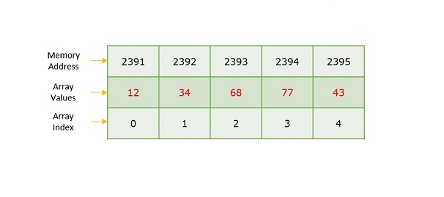
WEEK 11

Slide 3
Finding size without using sizeof operator ?
Deletion in array
Bubble sort of array
sizeof ......
searching
reverse printing the array

Slide 4
WEEK 11(LEC 22)

Slide 5
Home task :Write code Bubble sort an array

Slide 6
Funfact why bubble sort is called bubble sort ?
So why is it called bubble sort? Air bubbles that are more buoyant than surrounding water rise to the top. Similarly, list elements with greater value than their surrounding elements “bubble” to the end of the list.
Source [Why it’s called bubble sort.. Bubble sort is a sequential sort… | by ManBearPig | HackerNoon.com | Medium]

Slide 7
Code shared on gcr

Slide 8
امتحان کے لئے نیک خواہشات

Slide 9

Name :_____
Quiz :_____
Bring A4 pages in every class from now onward , we can have quiz /quizzes any time.
If quizzes are attempted on any other page than A4 white page , direct zero will be awarded.

Slide 10
THANK YOU
Allah says in Surah Luqman (interpretation of the meaning):
“And of mankind is he who purchases idle talks (i.e. music, singing) to mislead (men) from the path of Allah…” [Luqman 31:6]
The scholar of the ummah, Ibn 'Abbas (may Allah be pleased with him) said: this means singing . Mujahid (may Allah have mercy on him) said: this means playing the drum (tabl). (Tafsir al-Tabari, 21/40)
Al-Hasan al-Basri (may Allah have mercy on him) said: this ayah was revealed concerning singing and musical instruments (lit. woodwind instruments). (Tafsir Ibn Kathir, 3/451)

